Slide 1
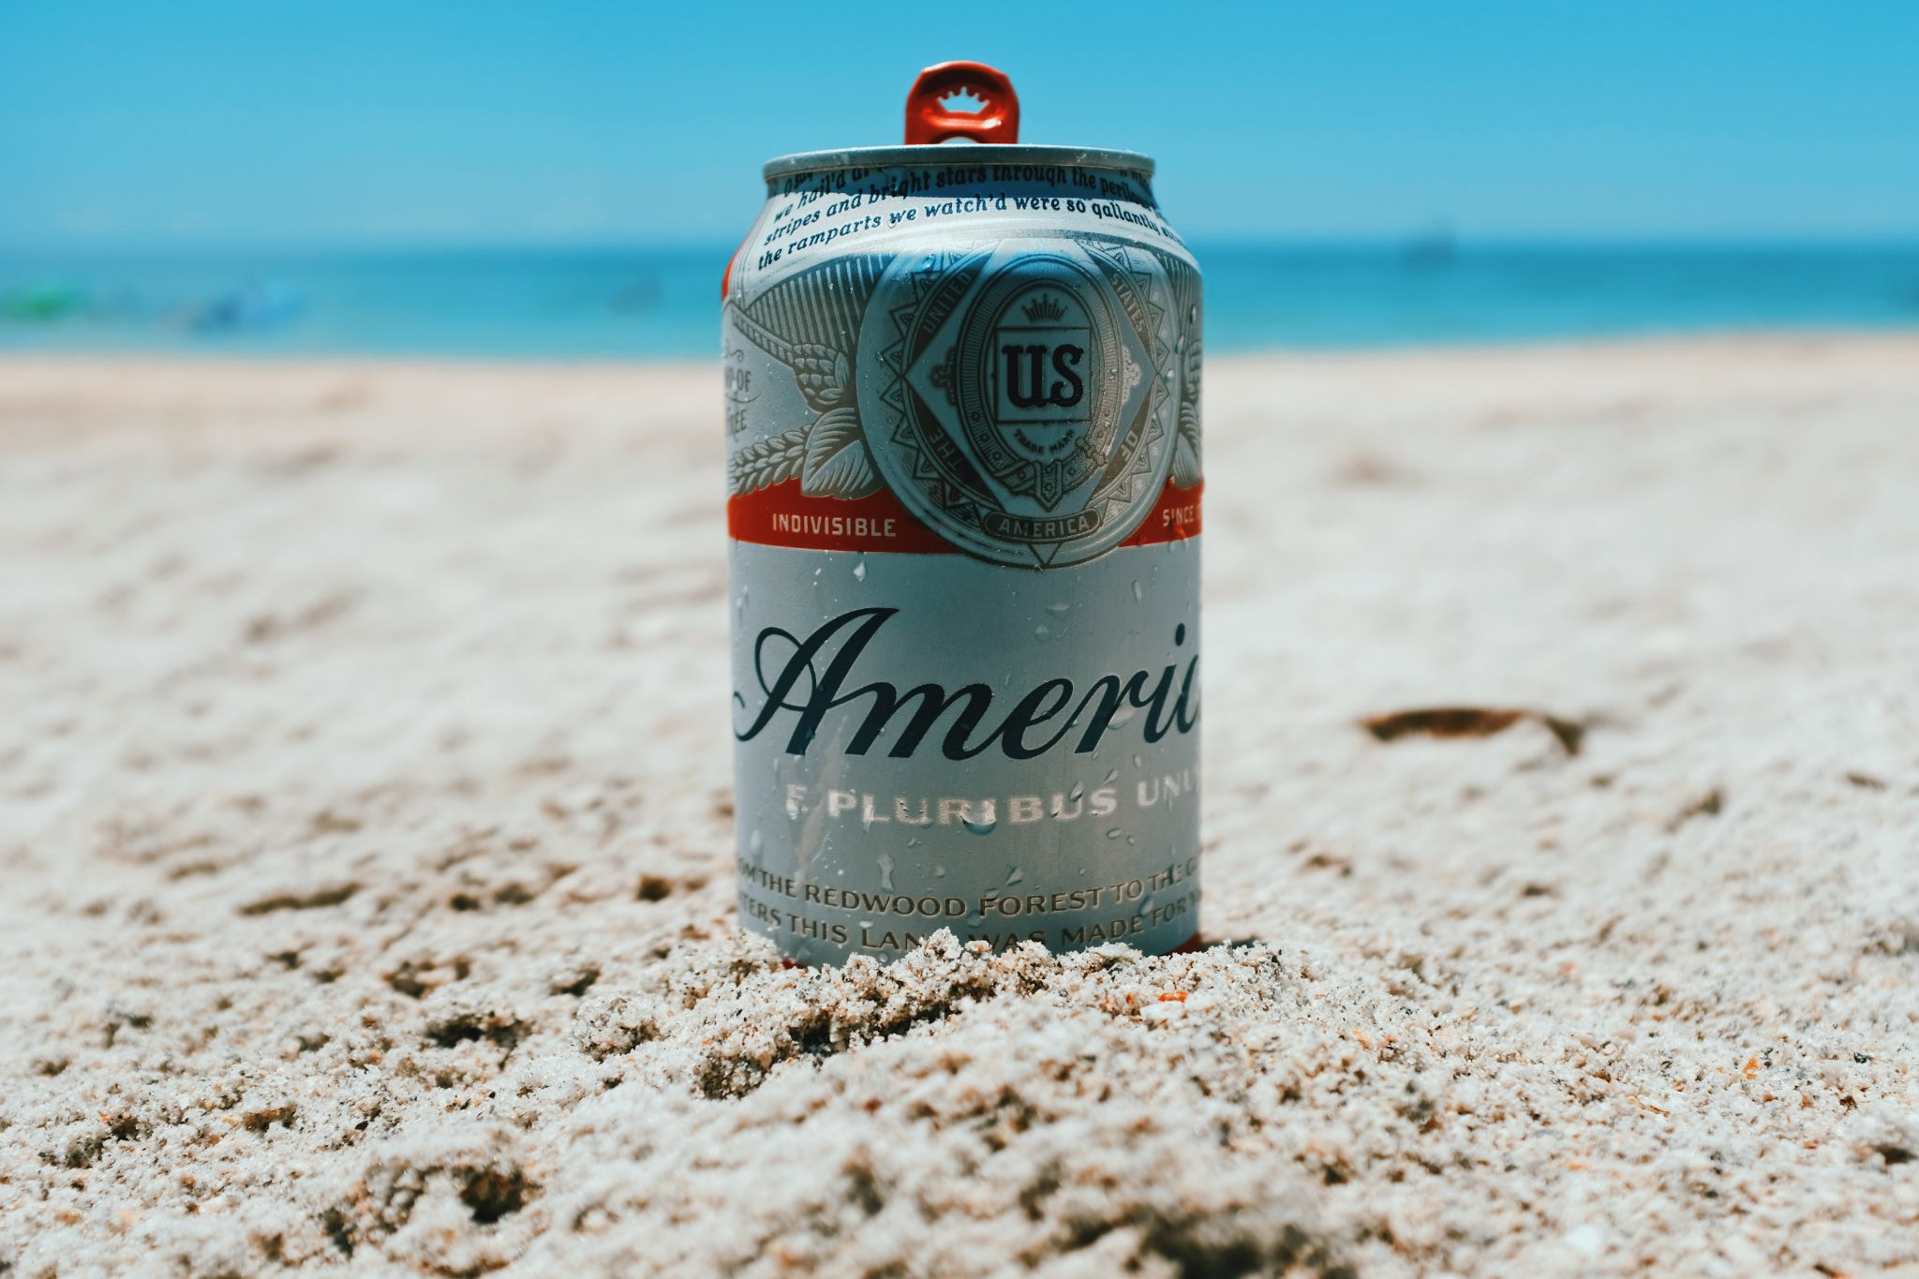
Budweiser Beer Analysis

Slide 2
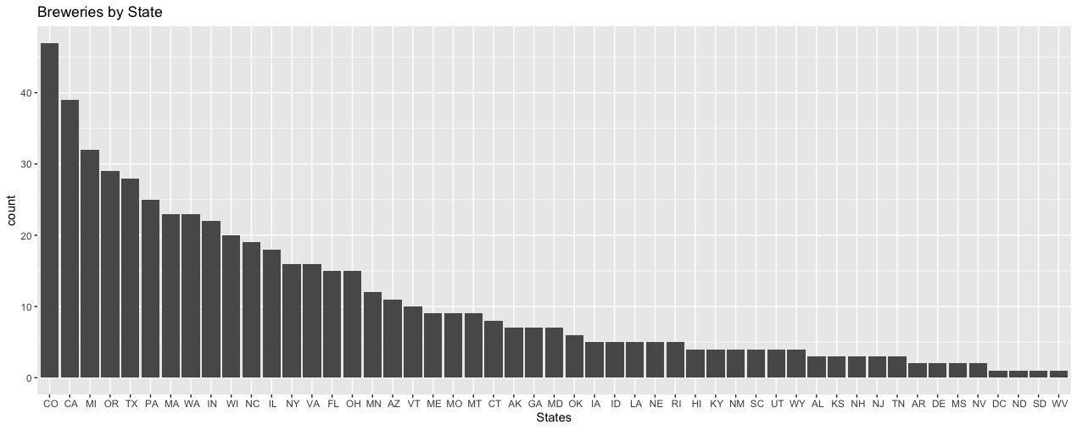
Analysis Question 1: Brewery Count in the United States
Colorado and California have the most breweries.
DC, North Dakota, South Dakota and West Virginia have least breweries.

Slide 3
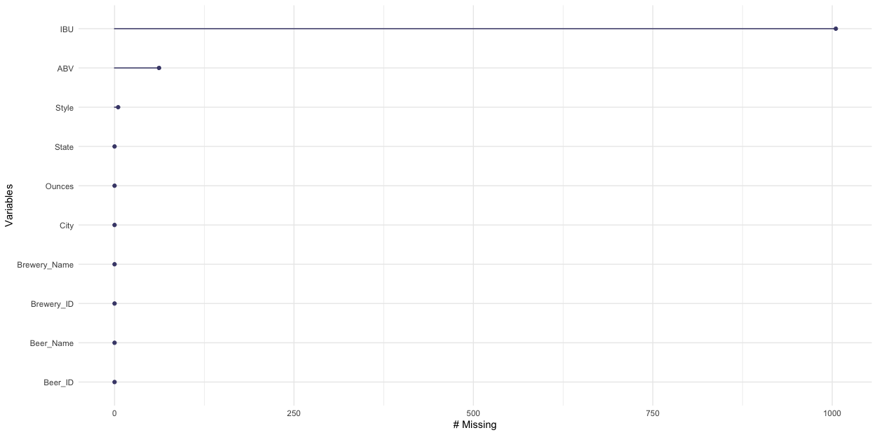
Analysis Question 2: Handling Missing Values
IBU and ABV have missing values with IBU having much greater amount. No replacement methods with be used to replace these values.
Strategies to Solve Missing Values Issue
No Replacement
Mean / Median Replacement
Software / Package Replacement (MICE)

Slide 4
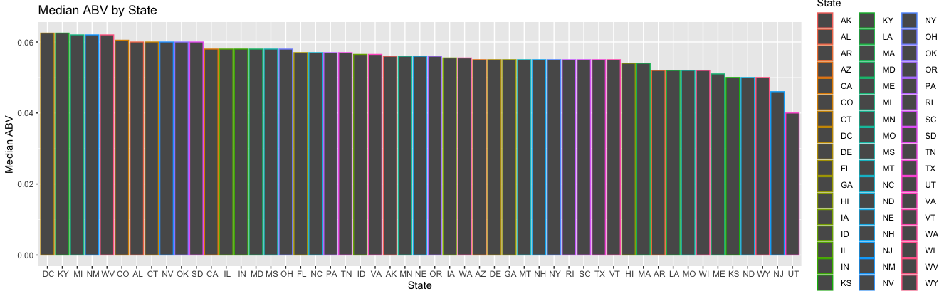
Analysis Question 3: Median Alcohol Content
There is slow drop-off of median ABV value with the greatest state being DC. New Jersey and Utah have a lower median ABV value than the rest of the states.

Slide 5
Analysis Question 4: Highest ABV and IBU Beers
 | Beer Name | ABV | IBU | Style | Brewery Name | City | State
Max ABV | Lee Hill Series Vol. 5 (2565) | 0.128 | NA | Quadrupel | Upslope Brewing Company | Boulder | CO
Max IBU | Bitter Bitch Imperial IPA (980) | 0.082 | 138 | American Double / Imperial IPA | Astoria Brewing Company | Astoria | OR

Slide 6

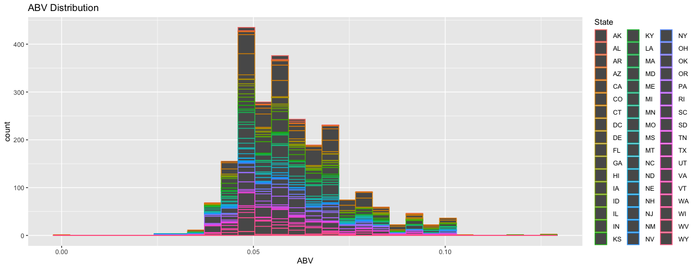
Analysis Question 5.1: ABV Distribution and Statistics
The distribution of ABV values is normally distributed with a slight right skew.

Slide 7
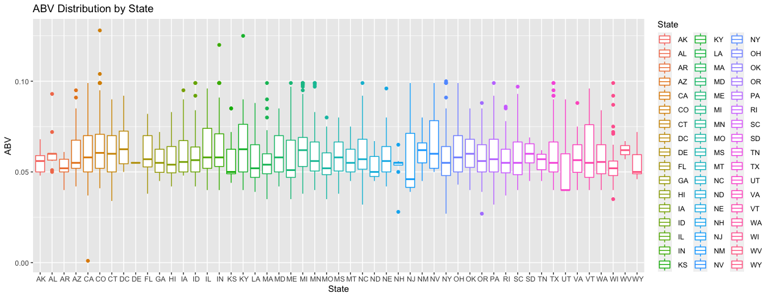
Analysis Question 5.2: ABV Distribution and Statistics
Each States ABV values are normally distributed. Utah and Delaware have more unique distributions than the rest of the states.

Slide 8
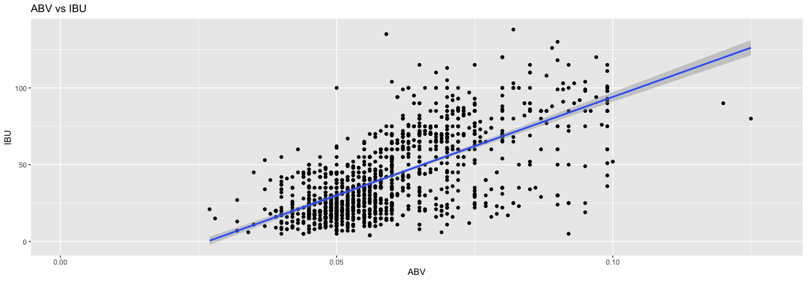
Analysis Question 6: Relationship Between ABV and IBU
There is a positive correlation between ABV and IBU. As beers become more alcoholic their bitterness tends to increase as well. Hop choice is large factor in this relationship. There is a soft cap at 10% alcohol as the quality of taste becomes worse.

Slide 9
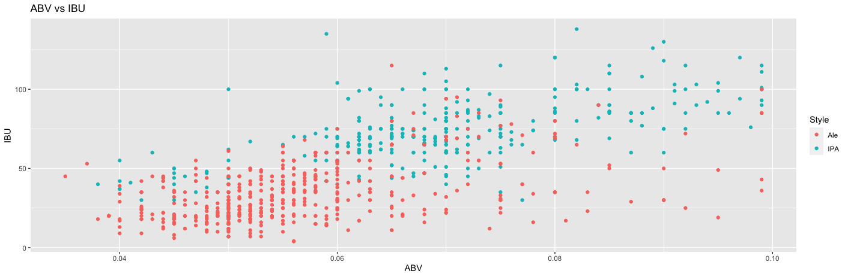
Analysis Question 7: Ale Beer vs IPA
There is a positive correlation between ABV and IBU, however there is distinct difference between ABV and IBU when taking into consideration the style of beer. A KNN model is roughly 83% accurate when predicting if a beer is an Ale or IPA based on the beer’s ABV and IBU values.

Slide 10
Analysis Question 8: State ABV Comparisons
All comparisons of each state were calculated, only 11 comparisons showed significant difference between ABV values. Most notably Colorado, Indiana and Michigan all have larger ABV values, while Utah, Wisconsin and Massachusetts all have much smaller ABV values. An ANOVA and pairwise t-test (Tukey Adjustment) were used to calculate these values.
Comparison | Difference | P-Value
CA - WI | 0.007023594 | 0.0498
CO - MA | 0.007689073 | 0.0063
CO - OR | 0.006308 | 0.0153
CO - UT | 0.011487385 | 0.0264
CO - WI | 0.009313176 | 0
IN - MA | 0.007711234 | 0.0306
IN - UT | 0.011509545 | 0.0454
IN - WI | 0.009335337 | 0.0005
MA - MI | -0.007694557 | 0.0239
MI - UT | 0.011492868 | 0.0416
MI - WI | 0.00931866 | 0.0003

Slide 11
THANK YOU

